Slide 1

Logistic Regression
(Classification Algorithm)
Dr. Muhammad Kamran Malik

Slide 2
Artificial Neural Networks
اَعُوذُ بِاللہِ مِنَ الشَّیِطٰنِ الرَّجِیمْ
بِسْمِ اللہِ الرَّحَمٰنِ الرَّحِیمْ
Note: Some slides and/or pictures are adapted from Lecture slides / Books of
https://www.coursera.org/specializations/deep-learning
https://d2l.ai/chapter_preface/index.html
https://deeplearning.cs.cmu.edu/S23/index.html

Slide 3
Contents
Broadcasting
Sigmoid Derivation
Binary Cross Entropy Derivation
Binary Classification
Notations
Logistic Regression
Impact of learning rate in Gradient Descent
How to implement Gradient Descent
Gradient Descent for Linear Regression

Slide 4

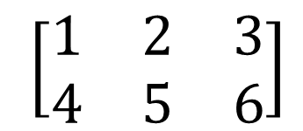
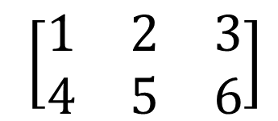
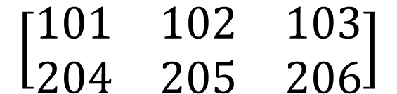
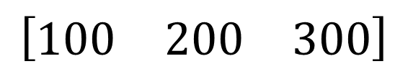
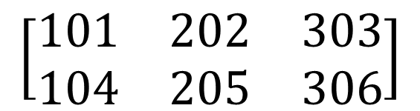

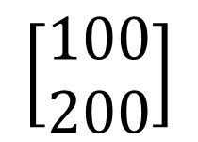
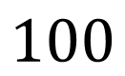
Broadcasting
$$\left[\begin{matrix}1 \\ \begin{aligned}\begin{matrix}2 \\ 3\end{matrix} \\ 4\end{aligned}\end{matrix}\right]$$
$$\left[\begin{matrix}101 \\ \begin{aligned}\begin{matrix}102 \\ 103\end{matrix} \\ 104\end{aligned}\end{matrix}\right]$$
$$100$$
=
+
$\left[\begin{matrix}1 & 2 & 3 \\ 4 & 5 & 6\end{matrix}\right]$
$$\left[\begin{matrix}100 & 200 & 300\end{matrix}\right]$$
$$\left[\begin{matrix}101 & 202 & 303 \\ 104 & 205 & 306\end{matrix}\right]$$
+
=
$\left[\begin{matrix}1 & 2 & 3 \\ 4 & 5 & 6\end{matrix}\right]$
$$\left[\begin{matrix}100 \\ 200\end{matrix}\right]$$
$$\left[\begin{matrix}101 & 102 & 103 \\ 204 & 205 & 206\end{matrix}\right]$$
+
=

Slide 5

OR
X1 X2 OR
0 0 0
0 1 1
1 0 1
1 1 1
$$w^{T}x+b$$

Slide 6
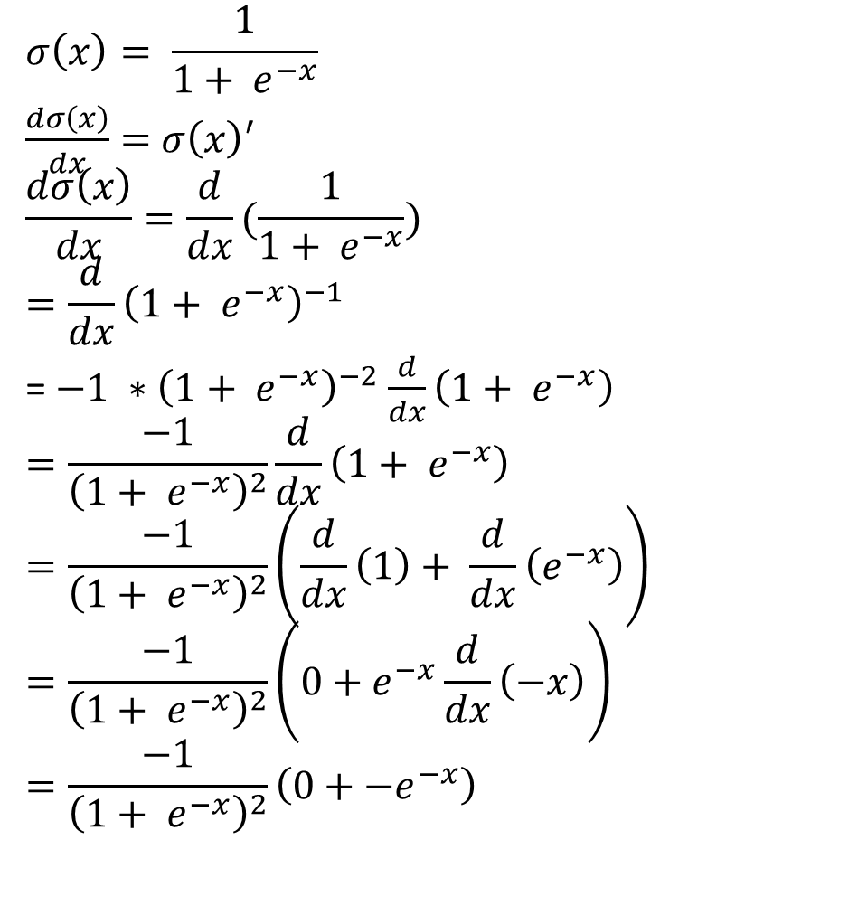
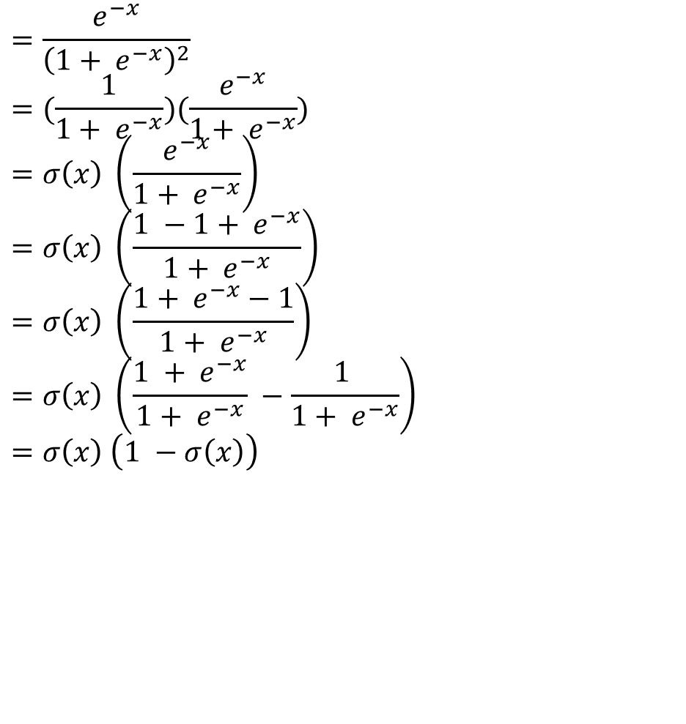
Sigmoid Derivation
$$σ\left(x\right)= \frac{1}{1+ e^{−x}}$$
$\frac{dσ\left(x\right)}{dx}=$ $σ\left(x\right)′$
$$\frac{dσ\left(x\right)}{dx}=\frac{d}{dx}(\frac{1}{1+ e^{−x}})$$
$$=\frac{d}{dx}{\left(1+ e^{−x}\right)}^{−1}$$
= $−1 ∗{\left(1+ e^{−x}\right)}^{−2}$ $\frac{d}{dx}\left(1+ e^{−x}\right)$
$$=\frac{−1}{{\left(1+ e^{−x}\right)}^{2}}\frac{d}{dx}\left(1+ e^{−x}\right)$$
$$=\frac{−1}{{\left(1+ e^{−x}\right)}^{2}}\left(\frac{d}{dx}\left(1\right)+ \frac{d}{dx}\left(e^{−x}\right)\right)$$
$$=\frac{−1}{{\left(1+ e^{−x}\right)}^{2}}\left(0+e^{−x}\frac{d}{dx}\left(−x\right)\right)$$
$$=\frac{−1}{{\left(1+ e^{−x}\right)}^{2}}\left(0+{−e}^{−x}\right)$$
$$=\frac{e^{−x}}{{\left(1+ e^{−x}\right)}^{2}}$$
$$=(\frac{1}{1+ e^{−x}})(\frac{e^{−x}}{1+ e^{−x}})$$
$$=σ\left(x\right) \left(\frac{e^{−x}}{1+ e^{−x}}\right)$$
$$=σ\left(x\right) \left(\frac{1 −1+ e^{−x}}{1+ e^{−x}}\right)$$
$$=σ\left(x\right) \left(\frac{1+ e^{−x}−1}{1+ e^{−x}}\right)$$
$$=σ\left(x\right) \left(\frac{1 + e^{−x}}{1+ e^{−x}} −\frac{1 }{1+ e^{−x}}\right)$$
$$=σ\left(x\right) \left(1 −σ\left(x\right)\right)$$
z | sig(z)
-2 | 0.12
-1.5 | 0.18
-1 | 0.27
-0.5 | 0.38
0 | 0.50
0.5 | 0.62
1 | 0.73
1.5 | 0.82
2 | 0.88
2.5 | 0.92
Notes:
https://eli.thegreenplace.net/2016/the-softmax-function-and-its-derivative/

Slide 7
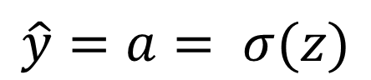
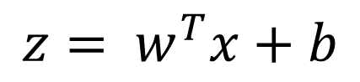
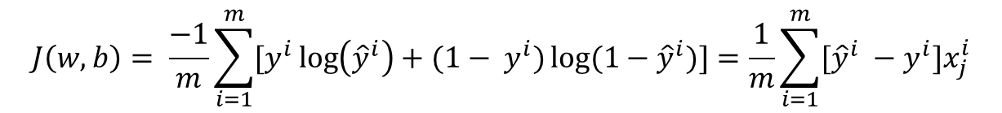
Binary Cross Entropy
$$z= w^{T}x+b$$
$$\hat{y}=a= σ(z)$$
$$ℒ\left(a,y\right)=−(y\log{(a)+(1−y)\log{(1−a))}}$$
$$ℒ\left(\hat{y},y\right)=−(y\log{(\hat{y})+(1−y)\log{(1−\hat{y}))}}$$
$$J\left(w,b\right)= \frac{−1}{m}\sum_{i=1}^{m}{[y^{i}\log\left({\hat{y}}^{i}\right)+{(1− y}^{i})\log{{(1−\hat{y}}^{i})}]}=\frac{1}{m}\sum_{i=1}^{m}{[{\hat{y}}^{i} −y^{i}]x_{j}^{i}}$$

Slide 8
Binary Classification
In a binary classification problem, the result is a discrete value output.
For example
Account hacked (1) or compromised (0) , Tumor malign (1) or benign (0) , Cat vs Non-Cat
The goal is to train a classifier that the input is an image represented by a feature vector, 𝑥, and predicts whether the corresponding label 𝑦̂ is 1 or 0. In this case, whether this is a cat image (1) or a non-cat image (0).
An image is stored in the computer in three separate matrices corresponding to the Red, Green, and Blue color channels of the image. The three matrices have the same size as the image, for example, the resolution of the cat image is 64 pixels X 64 pixels, the three matrices (RGB) are 64 X 64 each.
The value in a cell represents the pixel intensity which will be used to create a feature vector of n-dimension. In pattern recognition and machine learning, a feature vector represents an object, in this case, a cat or no cat.
To create a feature vector, 𝑥, the pixel intensity values will be “unroll” or “reshape” for each color. The dimension of the input feature vector 𝑥 is 𝑛_{𝑥} = 64 𝑥 64 𝑥 3 = 12 288.

Slide 9
Binary Classification
1 (cat) vs 0 (non cat)
Blue
Green
Red

Slide 10
Notations

Slide 11
Logistic Regression
Source: https://www.coursera.org/learn/machine-learning

Slide 12
Logistic Regression
Logistic regression is a learning algorithm used in a supervised learning problem when the output 𝑦 are all either zero or one. The goal of logistic regression is to minimize the error between its predictions and training data.
Example: Cat vs No - cat
Given an image represented by a feature vector 𝑥, the algorithm will evaluate the probability of a cat being in that image. 𝐺𝑖𝑣𝑒𝑛 𝑥 ,𝑦̂=𝑃(𝑦=1|𝑥), where 0 ≤𝑦̂≤1
The parameters used in Logistic regression are:

Slide 13
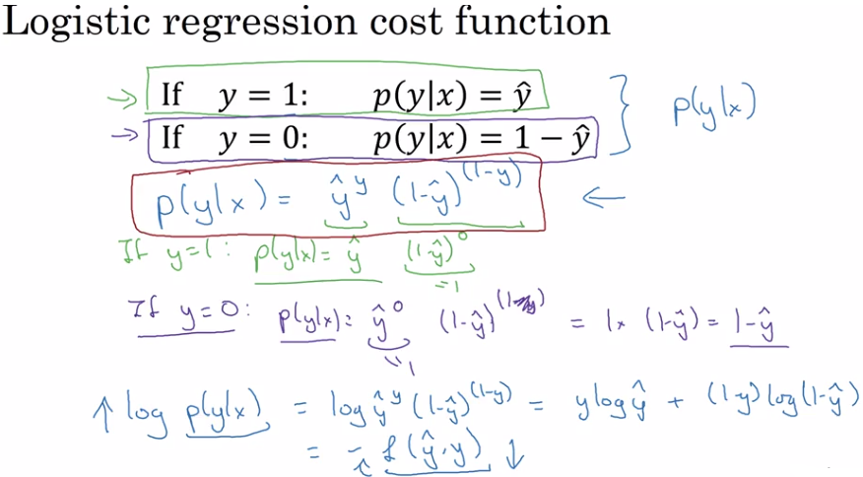
Bernoulli distribution is the probability distribution of a random variable which takes the value 1 with probability p and the value 0 with probability q=1-p i.e., the probability distribution of any single experiment that asks a yes–no question; the question results in a boolean-valued outcome, a single bit of information whose value is success/yes/true/one with probability p and failure/no/false/zero with probability q.
If X is a random variable with this distribution, we have: Pr(X=1)=p=1-Pr(X=0)=1-q
The probability mass function f of this distribution, over possible outcomes k, is f(k;p) = p if k=1, 1-p if k=0.
This can also be expressed as : =p^{k} 1-p^{1-k}
Notes:
Because the log function is a strictly monotonically increasing function, you're maximizing log p(y|x) should give similar result as you are optimizing p(y|x) and if you compute log of p(y|x), that's equal to log of y hat par y * 1- y hat sub par of 1- y. And so that simplifies to y log y hat + 1- y * log 1- y hat. And so this is actually negative of the loss function that we had to find previously.
And there's a negative sign there because usually if you're training a learning algorithm, you want to make probabilities large whereas in logistic regression we're expressing this. We want to minimize the loss function. So minimizing the loss corresponds to maximizing the log of the probability. So this is what the loss function on a single example looks like. How about the cost function, the overall cost function on the entire training set on m examples? Let's figure that out.
So, the probability of all the labels In the training set. Writing this a little bit informally. If you assume that the training examples I've drawn independently or drawn IID,
identically independently distributed, then the probability of the example is the product of probabilities. The product from i = 1 through m p(y(i) ) given x(i).
And so if you want to carry out maximum likelihood estimation, right,
then you want to maximize the, find the parameters that maximizes
the chance of your observations and training set.
But maximizing this is the same as maximizing the log, so
we just put logs on both sides.
So log of the probability of the labels in the training set is equal to,
log of a product is the sum of the log.
So that's sum from i=1 through m of log p(y(i)) given x(i).
And we have previously figured out on the previous
slide that this is negative L of y hat i, y i.

Slide 14
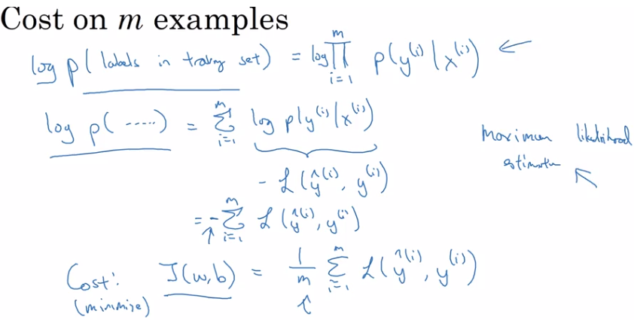

Slide 15
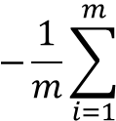
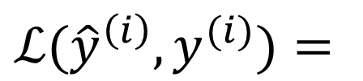
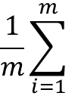
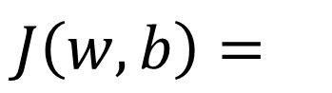

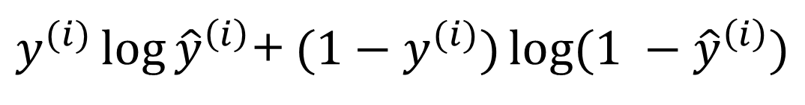
Recap: $\hat{y}= σ\left(w^{T}x+b\right)$, $σ\left(z\right)=\frac{1}{1+e^{−z}}$
$$\frac{1}{m}\sum_{i=1}^{m}{ }$$
$ℒ({\hat{y}}^{\left(i\right)},y^{(i)})$ $=$
$$−\frac{1}{m}\sum_{i=1}^{m}{ }$$
$$J\left(w,b\right)=$$
$y^{(i)}\log{{\hat{y}}^{\left(i\right)}}$+ $({1−y}^{(i)})\log{(1 −{\hat{y}}^{\left(i\right)})}$

Slide 16
Logistic Regression

Slide 17
Logistic Regression cost function
Loss (error) function: The loss function measures the discrepancy between the prediction (𝑦̂^{(𝑖)}) and the desired output (𝑦^{(𝑖)}). In other words, the loss function computes the error for a single training example.
Cost function: The cost function is the average of the loss function of the entire training set. We are going to find the parameters 𝑤 𝑎𝑛𝑑 𝑏 that minimize the overall cost function.

Slide 18
Logistic Regression cost function
$\hat{y} = σ\left(w^{T}x +b\right)$, where $σ\left(z \right)=\frac{1}{1+e^{−z}}$
Given $\left\{{(x}^{(1)},y^{(1)}\text{)}\text{,}\text{…}\text{,}{(x}^{(m)},y^{(m)}\text{)}\right\},$want ${\hat{y}}^{(i)}≈y^{\left(i\right)}$.
Loss (error) function:

Slide 19
Logistic Regression cost function
$\hat{y} = σ\left(w^{T}x +b\right)$, where $σ\left(z \right)=\frac{1}{1+e^{−z}}$
Given $\left\{{(x}^{(1)},y^{(1)}\text{)}\text{,}\text{…}\text{,}{(x}^{(m)},y^{(m)}\text{)}\right\},$want ${\hat{y}}^{(i)}≈y^{\left(i\right)}$.
Loss (error) function:

Slide 20
Logistic Regression cost function
$\hat{y} = σ\left(w^{T}x +b\right)$, where $σ\left(z \right)=\frac{1}{1+e^{−z}}$
Given $\left\{{(x}^{(1)},y^{(1)}\text{)}\text{,}\text{…}\text{,}{(x}^{(m)},y^{(m)}\text{)}\right\},$want ${\hat{y}}^{(i)}≈y^{\left(i\right)}$.
Loss (error) function:

Slide 21
Logistic regression on m examples

Slide 22
Q & A

